Slide 1



Team 16
Road Crash Detection System
Supervisor : Prof. Nevin Darwish

Slide 2
Our Team
Khaled Sabry
Mohamed Emad
Roba
Gamal
Esraa Mamdouh

Slide 3
Agenda
01
Motivation & Overview
04
Architecture & Tools
02
Research & Market Survey
05
Timeline Plan
03
Challenges
06
Future Work

Slide 4
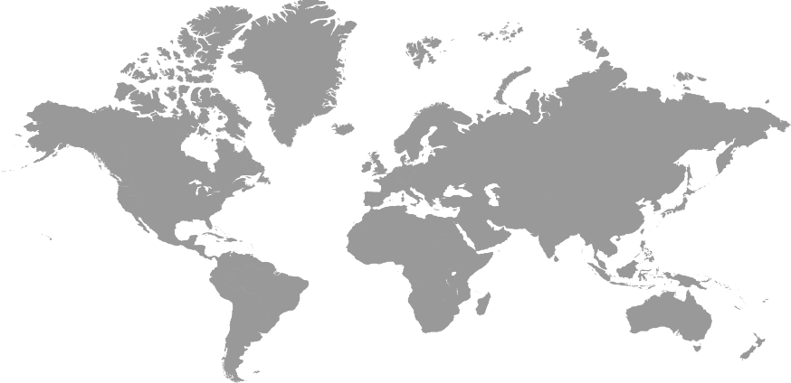
Motivation & Overview
20.000 Deaths
Russia
9000 Deaths
Egypt
40.000 Deaths
60.000 Deaths
USA
China
38.000 Deaths
Brazil
Source: World Health Organization
Data: 2018

Slide 5
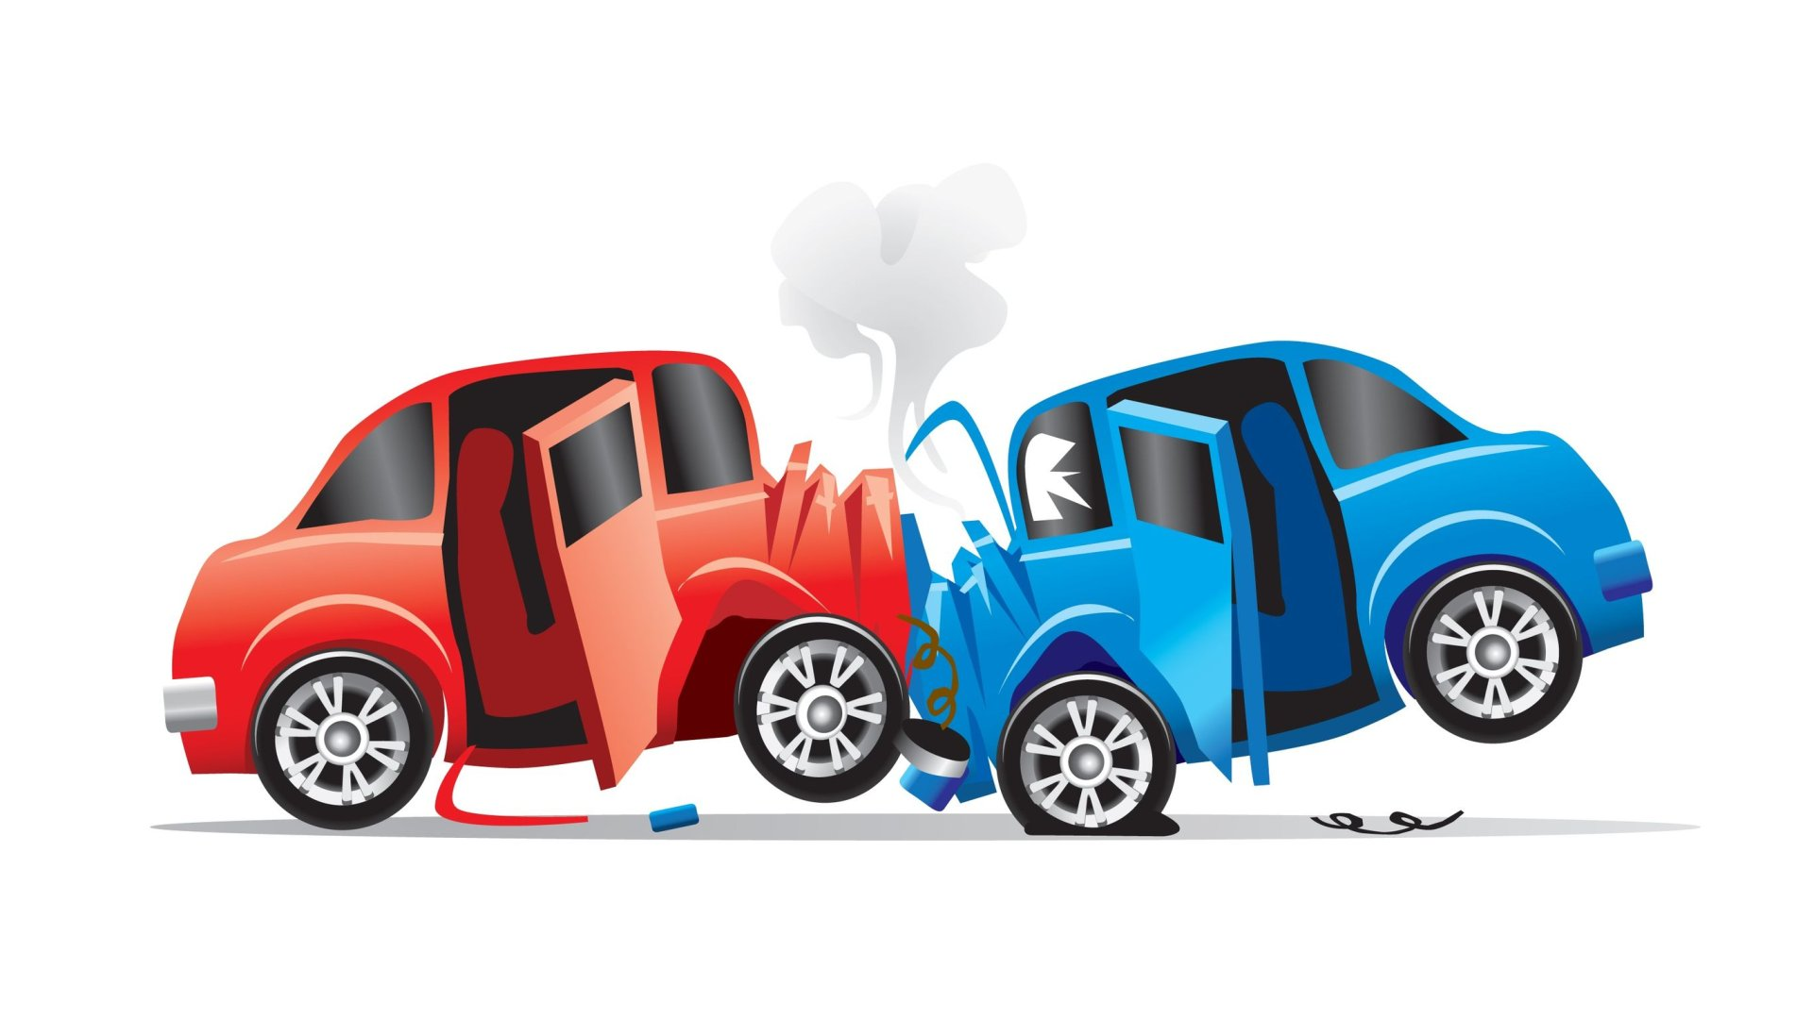



Motivation & Overview
Road Crash System

Slide 6



Research & Market Survey
Smartphone applications based on sensors
SOSmart
Personal Safety
Sensitive and not accurate
For pixels phones only

Slide 7
Research & Market Survey
Not found any application related to our problem based on Computer vision techniques in production. It is more of a research topic right now.

Slide 8


Challenges
Nature of Accidents
Technical Difficulties

Slide 9
Challenges - Nature of Accidents
Diverse Types of Vehicles
Different lighting and Angles
Crashes are Stochastic

Slide 10
Challenges - Technical Difficulties
Scarce Researches
Computational Power
Dataset

Slide 11
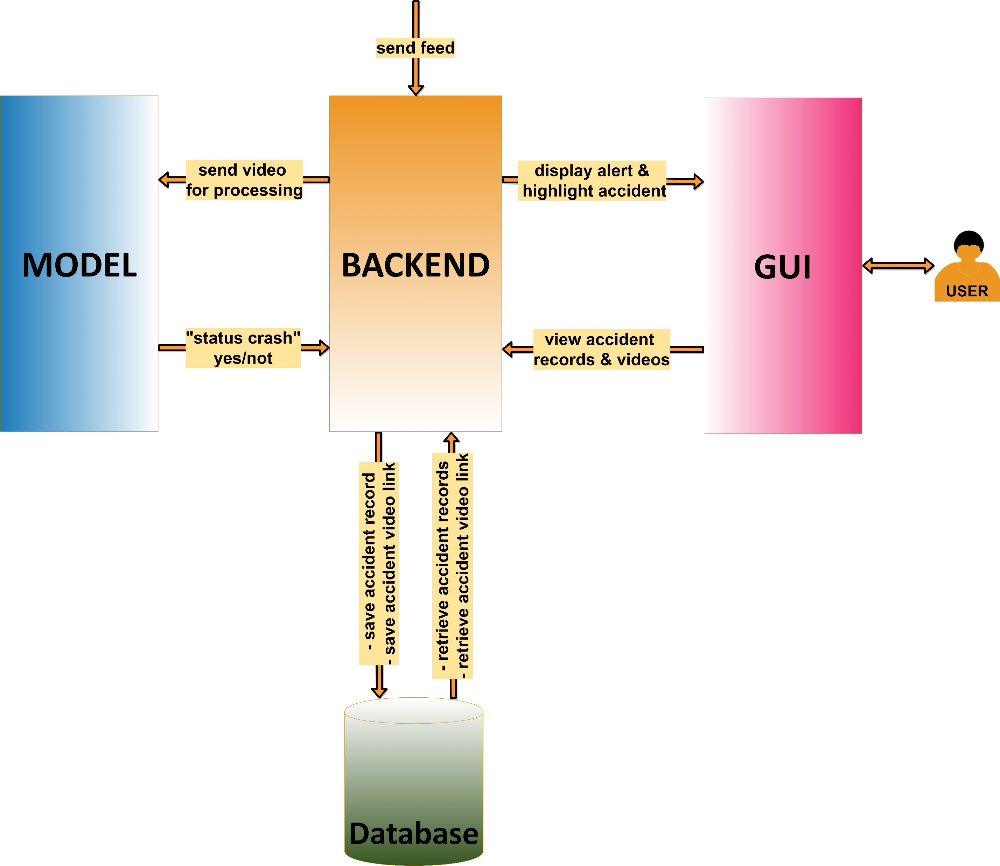
System Architecture
No Crash

Slide 12
System Architecture
?
Crash

Slide 13
System Architecture
Viewing

Slide 14
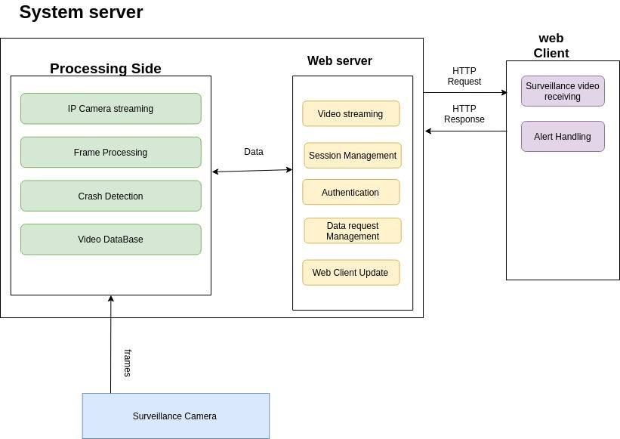
System Architecture

Slide 15




Tools

Slide 16
T I M E L I N E
Dec 2019 - Jan 2020
Mar 2020 - May 2020
Finding Dataset &
Choosing Model
Backend
&
Testing
Choosing Idea
Research & Market Survey
Training Model
&
Tuning Parameters
Sep 2019 - Oct 2019
Jan 2020 - Feb 2020
Jun 2020 – Jul 2020
Documentation

Slide 17
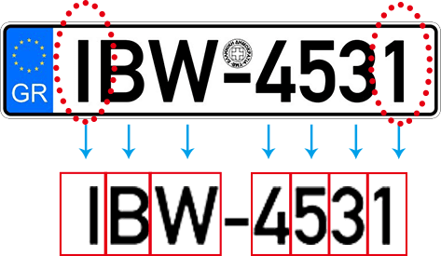
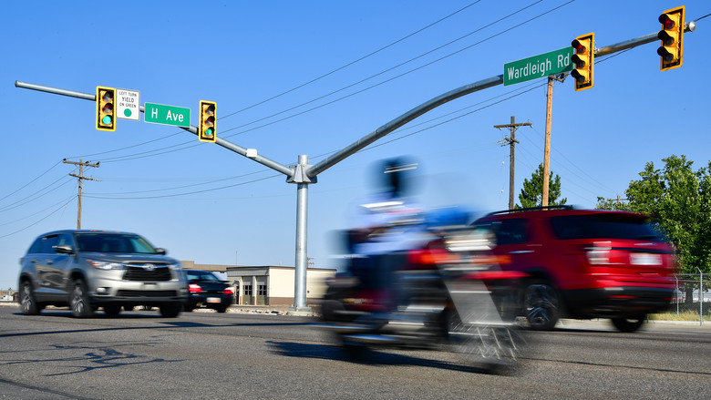
Future Work
OCR to car plate
Road Safety System
car plate identification system using OCR
monitor the roads and make sure traffic rules are followed

Slide 18
List of deliverables
Modules | Inputs | Outputs | Used libraries
Server side | stream of frames | message to indicate crash | Part of the architecture is cascading of CNNs ,each CNN will be generated by pytorch/Keras.
Client side | user instruction (inspect crash / respond to message) and/or message from server side. | retrieve accident | GUI tools like standard graphic tools(e.g react)
Saved Accident | standard dataset / youtube videos | semi automatic annotated dataset file suitable for Yolo architecture in form of csv file

Slide 19

Q U E S T I O N S ?

Slide 20

T H A N K Y O U

Slide 22
Team 16
Road Crash Detection System
Supervisor : Prof. Nevin Darwish

Slide 23
System Architecture
Detection
(YOLO)
Tracking
(Optical Flow)
VIF
descriptor
Approach 1
Frames
Is it crash?
Detection
(YOLO)
Classifier
(SVM/NN)
crashes features
Approach 2
Frames

Slide 24
List of deliverables
Modules | Inputs | Outputs | Used libraries
Backend | - Feed from camera | - Notification of accident - View of accident - Save Accident Frames | -
GUI | - Notifications from server | - View accidents | -
Model | - Frames | - Crash/ not a crash ? | Pytorch - OpenCv
Dataset | - Videos from YouTube | - Crash videos - No crash videos | -

